Slide 1
Breaking news
Data analysis of news from 2012-2018

Slide 2
Preliminary analysis
Three big groups of news
Social ('CRIME', 'WORLD NEWS', 'POLITICS', 'BLACK VOICES’, 'WOMEN', 'QUEER VOICES', 'BUSINESS', 'LATINO VOICES’, 'GREEN', 'WORLDPOST', 'MONEY', 'ENVIRONMENT’)
Cultural ('IMPACT', 'MEDIA', 'TECH', 'RELIGION', 'SCIENCE', 'EDUCATION', 'COLLEGE', 'ARTS & CULTURE', 'FOOD & DRINK’)
Entertainment ('ENTERTAINMENT', 'WEIRD NEWS', 'COMEDY', 'SPORTS', 'TRAVEL’, 'PARENTS', 'STYLE', 'TASTE', 'HEALTHY LIVING', 'GOOD NEWS’, 'FIFTY', 'WELLNESS', 'HOME & LIVING','DIVORCE', 'WEDDINGS’)
If we plot by date, the number of news in each of those categories we obtained something like this.

Slide 3
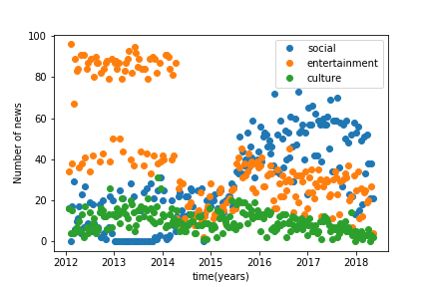
Preliminary analysis
It looks like in the first years of the website the news were more about comedy, sports, taste, weeding, etc.
In the last years, the social news are getting more and more common.
In some dates, we can see a maxima in social and entertainment
The culture news are constant in all the years

Slide 4
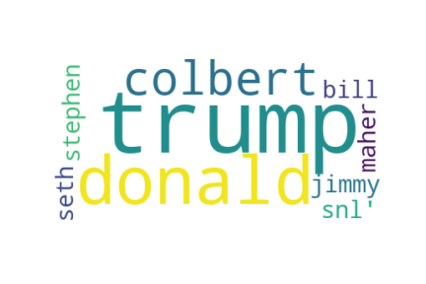

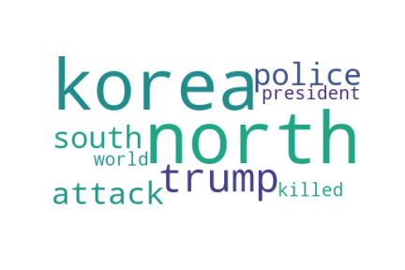
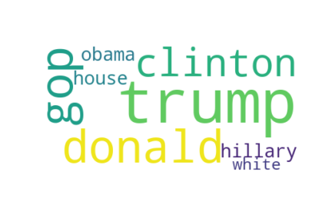
Preliminary analysis
Now we can find the most common words in the titles of each category, ignoring the common English words like the, that, those, etc. (Trump is one of the most common word)
Comedy
World Post
World News
Politics

Slide 5

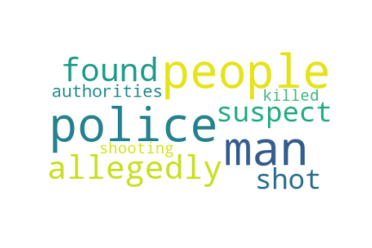


Preliminary analysis
Now we can find the most common words in the short descriptions of each category, ignoring the common English words like the, that, those, etc.
College
Religion
Art
Crime

Slide 6
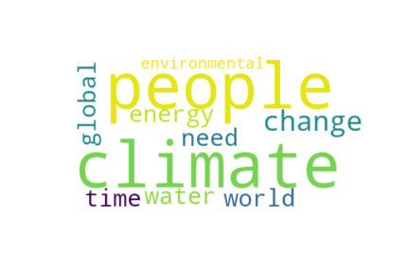
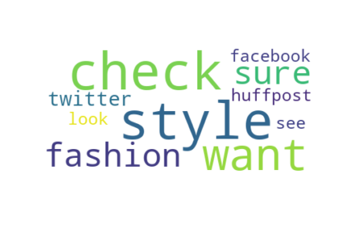
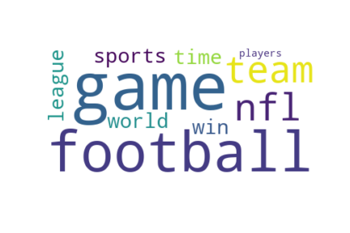
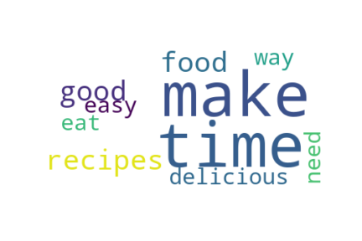
Preliminary analysis
If you see the common words in each description, it is easy to guess the category that belongs to each words. For example, football for sports, or climate for green news.
Sports
Taste
Green
Style

Slide 7
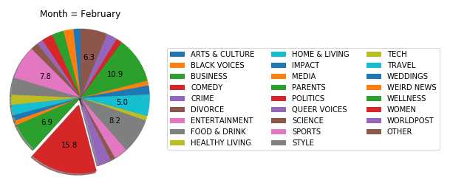
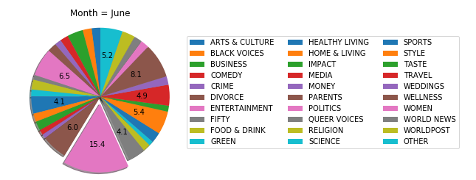
Preliminary analysis
We can also find the most common categories in each month; in each case the most common category (politics) take less than 20% of the news for that month.

Slide 8
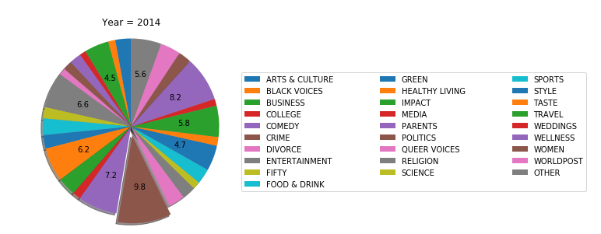
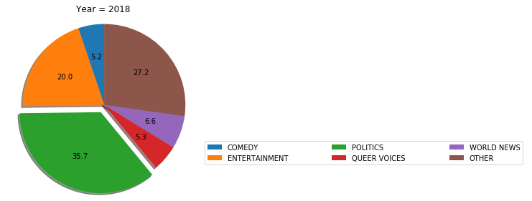
Preliminary analysis
We can also find the most common categories in each year; we can see how the diversity of news was bigger in the first years of the newspaper

Slide 9
Encoding the text
Transform each word of the text in a vector, this mathematic tool will depend on the importance of the word, in other words, the frequency of this word and the places that this word occupy in the sentence.
After that we obtained a matrix with features, columns of the matrix, corresponding to the most important words and a score of each of this words for the specific sample.
With this matrix we can solve the ML problem with the numbers of features as dimensions

Slide 10
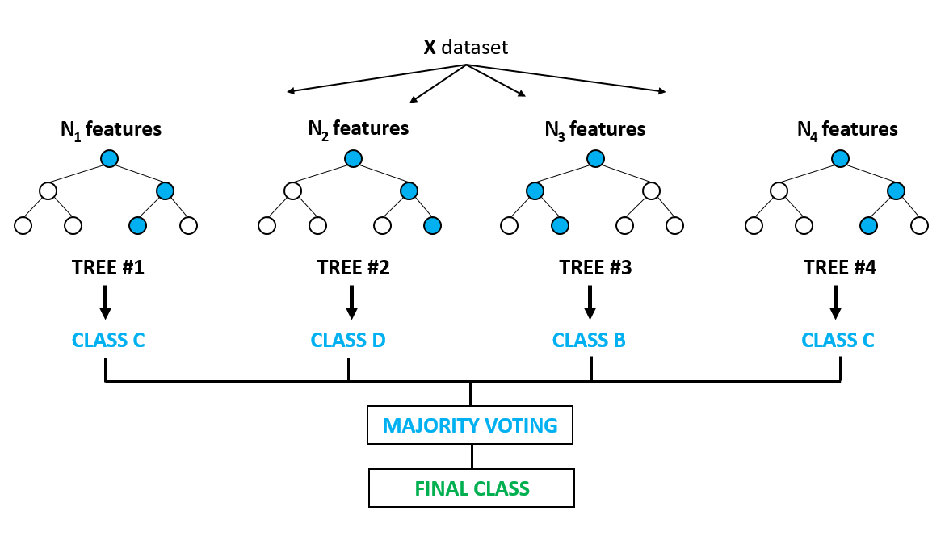
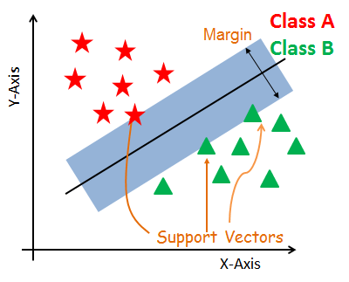
Machine learning
Random Forest
Support vector classifier
Accuracy : 0.2 – low training time
Accuracy : 0.36 – low training time

Slide 11
Perspectives
Transform the text date with different algorithms in order to find the best algorithm for this specific type of data.
Stablish a pipeline that’ll be able to determinate which algorithm is better to encode the text in terms of the performance of the ML algorithms.
Try to use RNNs to encode and predict the category of the data

Slide 12
GitHub link
You can see my code in the next link:
https://github.com/dagarzon1/Prueba_Tecnica

